Slide 1
DIABETES mellitus: An overview
DR. THANESWAR BORAH, MD

Slide 2
INTRODUCTION:
The number of people with type 1 and 2 diabetes mellitus (T2DM) is increasing rapidly and the latest figures are 387 million people with diabetes globally which is projected to rise to 592 million people in 2035. what is worse is that almost half of the people with diabetes remain undiagnosed. The disease burden due to diabetes is higher in low and middle income countries where four out of five people (80%) now reside. India, one of the largest countries in the Southeast Asian region, has more than 67 million people with diabetes, and this is expected to increase to 101 million by 2035.

Slide 3
DEFINITION: Diabetes Mellitus is a group of metabolic disorder involving carbohydrate, lipid and protein metabolism characterized by chronic hyperglycemia, as a result of defects in insulin secretion from β-cells of pancreas or peripheral action of insulin (insulin resistance) or both.

Slide 4
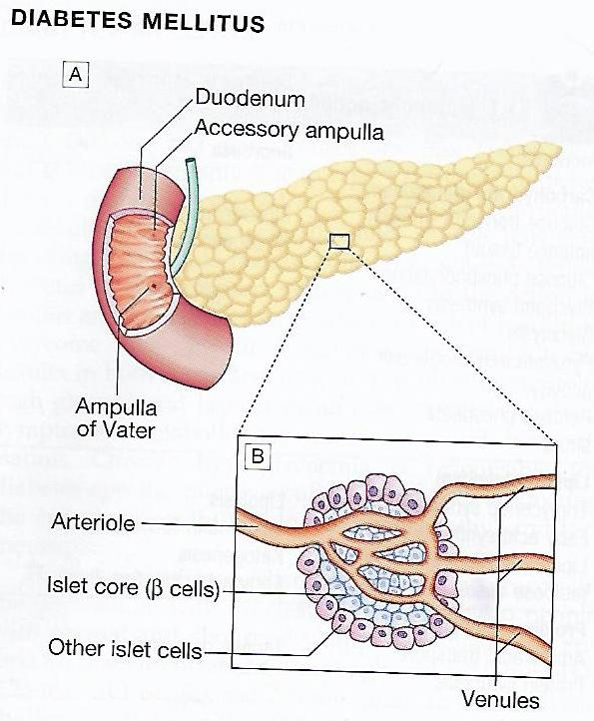
PENCITIC ISLET (BETA CELL)

Slide 5
METABOLIC ACTION OF INSULIN
INCREASE | DECREASE
CARBOHYDRATE METABOLISM
Glucose transport (muscle, adipose tissue) | Gluconeogenesis, Glycogenolysis
Glucose phosphorylation
Glycogen synthesis
Glycolysis
Pyruvate dehydrogenase
Activity
Pentose phosphate
Shunt

Slide 6
INCREASE | DECREASE
LIPID METABOLISM
Triglyceride Synthesis | Lipolysis
Fatty acid synthesis (liver) | Lipoprotein lipase (muscle)
Lipoprotein Lipase Activity | Ketogenesis
(Adipose Tissue) | Fatty acid oxidation (liver)
PROTEIN METABOLISM
Amino acid Transport | Protein Degradation
Protein synthesis

Slide 7
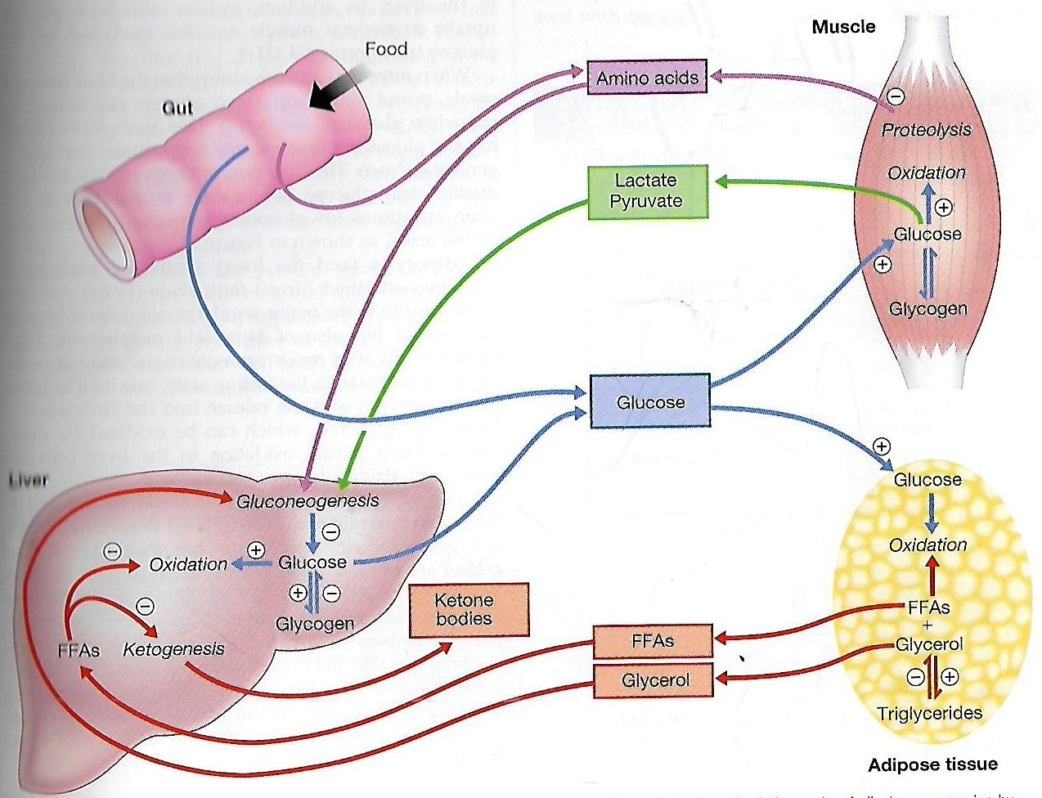
GLUCOSE METABOLISM

Slide 8
REGULATION OF GLUCOSE HOMEOSTASIS
Glucose homeostasis reflects a balance between hepatic glucose production and peripheral glucose uptake and utilization.
Insulin is the most important regulator of this metabolic equilibrium, but neural input, metabolic signals, and other hormones (e.g., glucagon) result in integrated control of glucose supply and utilization.
In the fasting state, low insulin levels increase glucose production by promoting hepatic gluconeogenesis and glycogenolysis and reduce glucose uptake in muscles and fat.
Postprandially, the glucose load elicits a rise in insulin and fall in glucagon, leading to a reversal of these processes.
Insulin, an anabolic hormone, promotes the storage of carbohydrate and fat and protein synthesis.
The major portion of postprandial glucose is used by skeletal muscle, an effect of insulin-stimulated glucose uptake.

Slide 9
RISK FACTORS FOR TYPE 2 DIABETES
Physical
inactivity
Overweight and obesity
High-fat and
low-fiber diet
Age
Urbanization
Family
history
Low birth weight
Ethnicity
Notes:
While some risk factors are fixed (such as age, gender and genetic background), many others are modifiable. The more risk factors a person has, the greater their likelihood of developing type 2 diabetes. Given that risk factors often occur together, all should be treated to gain the most benefit in terms of reducing type 2 diabetes.
Modified from the IDF publication: ‘Diabetes and Obesity’, p.12; and ‘Time to Act’, p.53

Slide 10
DIAGNOSIS OF DIABETES MELLITUS

Slide 11
DIAGNOSIS OF DIABETES AND PRE-DIABETES
Diabetes is confirmed by either:
Plasma glucose in random sample or 2 hrs after a 75 g glucose load ≥ 11.1 (200 mg/dL) or
Fasting plasma glucose ≥ 7.0 mmol/L (126 mg/dL)
In asymptomatic patients, two diagnostic tasts are required to confirm diabetes.
‘PRE-DIABETES’ IS CLASSIFIED AS:
Impaired fasting glucose = fasting plasma glucose ≥ 6.0 (108 mg/dL) and < 7.0 mmol/L (126 mg/dL)
Impaired glucose tolerance = fasting plasma glucose
<7.0 mmol/L (126 mg/dL) and 2-hr glucose after 75 g oral glucose drink 7.8-11.1 mmol/L (140-200 mg/dL)

Slide 12
AETIOLOGICAL CLASSIFICATION OF DIABETES MELLITUS
Type 1 diabetes:
Immune-mediated
Idiopathic
Type 2 diabetes:
Other specific types
Genetic defects of β-cell function
Genetic defects of insulin action (e.g. leprechaunism, lip dystrophies)
Pancreatic disease (e.g. pancreatitis, pancreatectomy, neoplastic disease, cystic fibrosis)
Drug-induced (e.g. corticosteroids, thiazide diuretics, phenytoin)

Slide 13
Excess endogenous production of hormonal antagonists to insulin,
e.g:
Growth Hormone - Acromegaly
Glucocorticoids – Cushing’s syndrome
Glucagon – Glucagonoma
Catecholamine's - Phaeochromocytoma

Slide 14
SYMPTOMS OF HYPERGLYCAEMIA
Thirst, dry mouth
Polyuria
Nocturia
Tiredness, fatigue, lethargy
Change in weight (usually weight loss)
Blurring of vision
Pruritus vulvae, balanitis (genital candidiasis)
Nausea
Headache
Hyperphagia; predilection for sweet foods
mood change, irritability, difficulty in concentrating, apathy

Slide 15
INVESTIGATIONS
Blood sugars: Fasting, 2 hours postprandial blood sugar(PPBS), Glycosylated Hb should be done.
urine for sugar, albumin, microalbuminuria, pus cells for urinary tract infection Liver, renal and lipid profile.
X-ray chest for heart enlargement, pulmonary tuberculosis.
Plain X-ray abdomen for pancreatic calcification.
Electrocardiogram (ECG) and stress test to rule out ischemic heart disease (IHD)

Slide 16
2D echocardiography to rule out diabetic cardiomyopathy.
Carotid and vertebral arteries Doppler for cerebrovascular accidents
In patients having peripheral artery disease, Doppler study of femoral and popliteal arteries.
Ultrasonography (USG) of abdomen and pelvis for nephropathy, renal stones

Slide 17
TYPES OF DIABETES:
1. Type 1 diabetes (absolute insulin deficiency)
2. Type 2 diabetes (Predominantly insulin resistance with relative insulin deficiency)
3. Gestational diabetes mellitus (7% of all Indian pregnancies)

Slide 18
TYPE 1 DIABETES:
Was previously called insulin-dependent diabetes mellitus (IDDM) or juvenile-onset diabetes.
Type 1 diabetes develops when the body’s immune system destroys pancreatic beta cells, the only cells in the body that make the hormone insulin that regulates blood glucose.
This form of diabetes usually strikes children and young adults, although disease onset can occur at any age.
Type 1 diabetes may account for 5% to 10% of all diagnosed cases of diabetes.
Risk factors for type 1 diabetes may include autoimmune, genetic, and environmental factors.

Slide 19
PATHOGENESIS
TYPE 1 DIABETES:
Type 1 DM is the result of interactions of genetic, environmental, and immunologic factors that ultimately lead to the destruction of the pancreatic beta cells and insulin deficiency.
Age 20 yrs commonly.
Auto immune destruction of beta-cells genetic predisposition.
Autoimmunity triggered functions are- infection, environmental stimulus.
Diabetes develop when 70-80% beta cell loss.

Slide 20
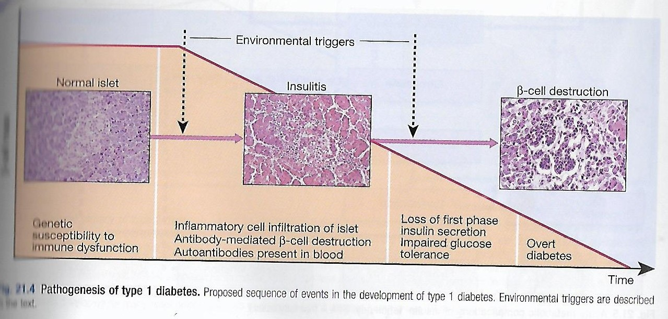

Slide 21
TYPE 2 DIABETES:
Was previously called non-insulin-dependent diabetes mellitus (NIDDM) or adult-onset diabetes.
Type 2 diabetes may account for about 90% to 95% of all diagnosed cases of diabetes.
It usually begins as insulin resistance, a disorder in which the cells do not use insulin properly. As the need for insulin rises, the pancreas gradually loses its ability to produce insulin.
Type 2 diabetes is associated with older age, obesity, family history of diabetes, history of gestational diabetes, impaired glucose metabolism, physical inactivity, and race/ethnicity.
Type 2 diabetes is increasingly being diagnosed in children and adolescents.

Slide 22
TYPE 2 DM:
Type 2 DM is characterized by-
Impaired insulin secretion.
Insulin resistance.
Excessive hepatic glucose production.
Abnormal fat metabolism.
Genetic susceptibility.

Slide 23
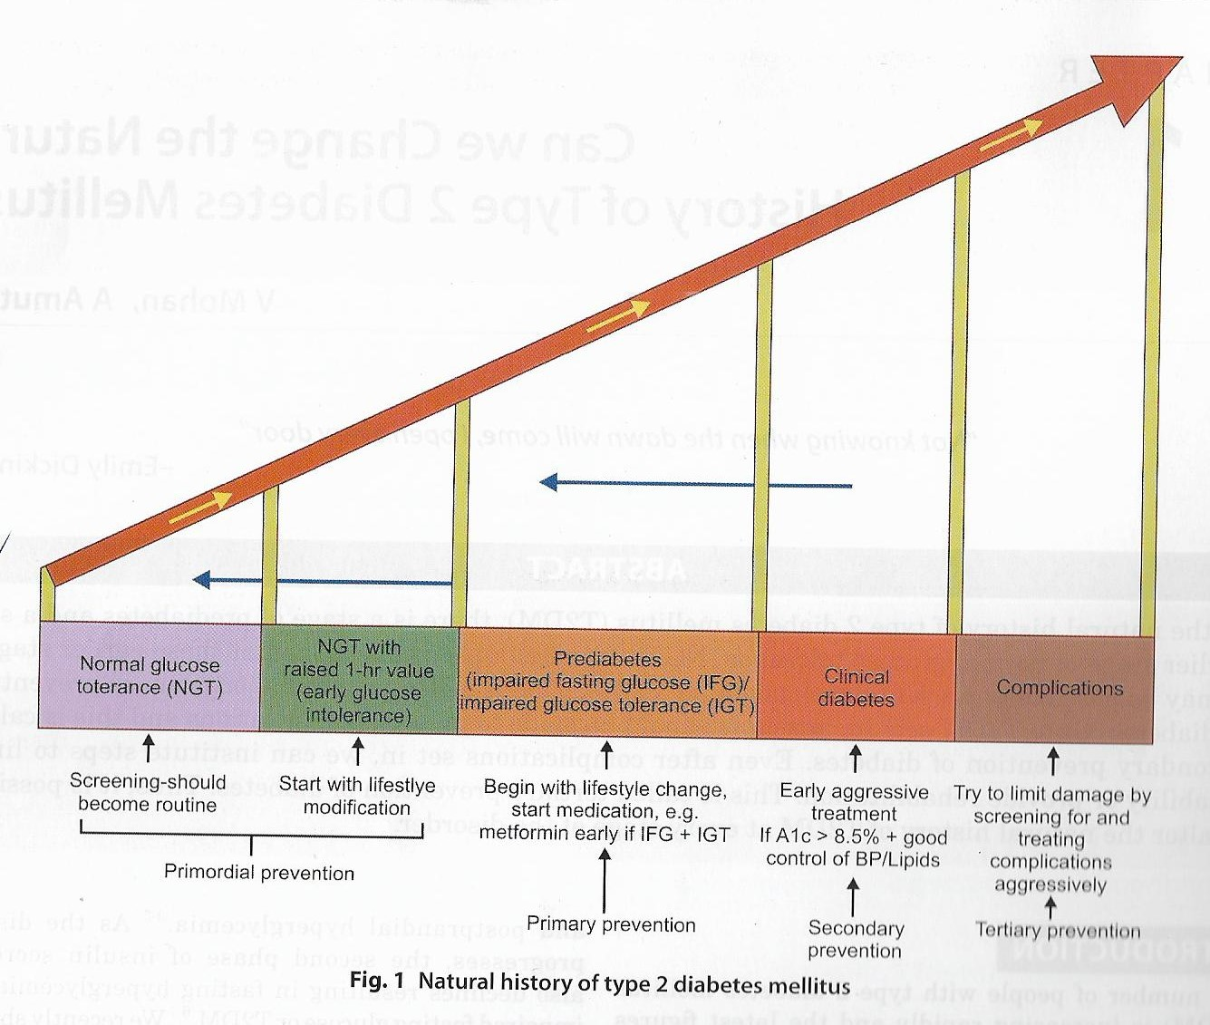

Slide 24
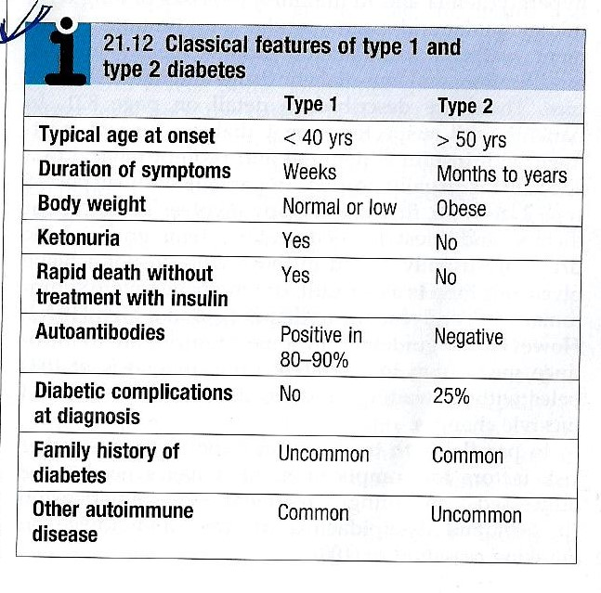

Slide 25
GESTATIONAL DIABETES
A form of glucose intolerance that is diagnosed in some women during pregnancy.
Gestational diabetes occurs more frequently among African Americans, Hispanic/Latino Americans, and American Indians. It is also more common among obese women and women with a family history of diabetes.
During pregnancy, gestational diabetes requires treatment to normalize maternal blood glucose levels to avoid complications in the infant.
After pregnancy, 5% to 10% of women with gestational diabetes are found to have type 2 diabetes.
Women who have had gestational diabetes have a 20% to 50% chance of developing diabetes in the next 5-10 years.

Slide 26
OTHER TYPES OF DM:
Other specific types of diabetes result from specific genetic conditions (such as maturity-onset diabetes of youth), surgery, drugs, malnutrition, infections, and other illnesses.
Such types of diabetes may account for 1% to 5% of all diagnosed cases of diabetes.

Slide 27
SECONDARY DM:
Secondary causes of Diabetes mellitus include:
Acromegaly,
Cushing syndrome,
Thyrotoxicosis,
Pheochromocytoma
Chronic pancreatitis,
Cancer
Drug induced hyperglycaemia:
  Atypical Antipsychotics - Alter receptor binding characteristics, leading to increased insulin resistance.
  Beta-blockers - Inhibit insulin secretion.
  Calcium Channel Blockers - Inhibits secretion of insulin by interfering with cytosolic calcium release.
  Corticosteroids - Cause peripheral insulin resistance and gluconeogensis.
  Fluoroquinolones - Inhibits insulin secretion by blocking ATP sensitive potassium channels.
  Niacin - They cause increased insulin resistance due to increased free fatty acid mobilization.
  Phenothiazines - Inhibit insulin secretion.
  Protease Inhibitors - Inhibit the conversion of proinsulin to insulin.
  Thiazide Diuretics - Inhibit insulin secretion due to hypokalemia. They also cause increased insulin resistance due to increased free fatty acid mobilization.

Slide 28
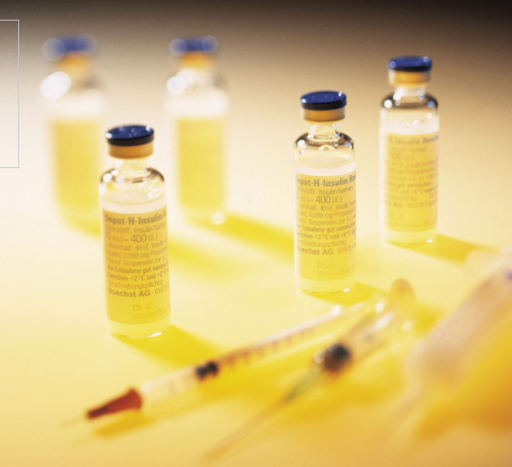
Management of Diabetes Mellitus

Slide 29
GOALS OF DIABETES MANAGEMENT
Individualization of treatment regimen
Achievement of metabolic status at normal or as close to normal as possible, especially blood glucose and lipid concentrations
Achievement and maintenance of normal or reasonable body-weight.
Adherence to a sound, realistic and appropriate diet and exercise programme.
Attainment of normal quality of life without symptoms referable to diabetes
Attainment of utility towards family and society.

Slide 30
TREATMENT GOALS FOR ADULTS WITH DIABETES
INDEX | GOAL
Glycemic control
HbA1c | <7.0%
Preprandial capillary plasma glucose | 4.4-7.2 mmol/L (80-130 mg/dL)
Peak postprandial capillary plasma glucose | <10.0 mmol/L (<180 mg/dL)
Blood pressure | <140/90 mmHg
Lipids
Low-density lipoprotein | <2.6 mmol/L (100 mg/dL)
High-density lipoprotein | >1 mmol/L (40 mg/dL) in men >1.3 mmol/L (50 mg/dL) in women
Triglycerides | <1.7 mmol/L (150 mg/dL)

Slide 31
MANAGEMENT OF DM
The major components of the treatment of diabetes are:
A
Diet and Exercise
B
Oral hypoglycaemic therapy
C
Insulin Therapy

Slide 32
A. Diet
Diet is a basic part of management in every case. Treatment cannot be effective unless adequate attention is given to ensuring appropriate nutrition.
Dietary treatment should aim at:
  ensuring weight control
  providing nutritional requirements
  allowing good glycaemia control with blood glucose levels as close to normal as possible
  correcting any associated blood lipid abnormalities

Slide 33
A. Diet (cont.)
The following principles are recommended as dietary guidelines for people with diabetes:
Dietary fat should provide 25-35% of total intake of calories but saturated fat intake should not exceed 10% of total energy. Cholesterol consumption should be restricted and limited to 300 mg or less daily.
Protein intake can range between 10-15% total energy (0.8-1 g/kg of desirable body weight). Requirements increase for children and during pregnancy. Protein should be derived from both animal and vegetable sources.
Carbohydrates provide 50-60% of total caloric content of the diet. Carbohydrates should be complex and high in fibre.
Excessive salt intake is to be avoided. It should be particularly restricted in people with hypertension and those with nephropathy.

Slide 34
CALORIE INTAKE BASED ON ACTIVITY
LIFESTYLE
Sedentary
Moderately active
DAILY CALORIE REQUIREMENT
20-25 Kcals/kg of IBW
26-30 Kcals/Kg of IBW
Strenuous
31-35 Kcals/Kg of IBW

Slide 35
Measuring obesity
Body Mass Index
Obesity is most commonly assessed by a single measure, the Body Mass Index (BMI), which uses a mathematical formula based on a person’s height and weight.
BMI = weight (kg)/height (m²)
Individuals with a BMI
  between 25 to 29.9 are considered overweight
  of 30 and above are considered obese.
The risk of serious health consequences such as type 2 diabetes, coronary heart disease, hypertension, dyslipidaemia, albuminuria and a wide range of other conditions increases with BMI.
Notes:
From the IDF Publication: ‘Diabetes and Obesity’, p.9 and p.17–18

Slide 36
Exercise
Physical activity promotes weight reduction and improves insulin sensitivity, thus lowering blood glucose levels.
Together with dietary treatment, a programme of regular physical activity and exercise should be considered for each person. Such a programme must be tailored to the individual’s health status and fitness.
People should, however, be educated about the potential risk of hypoglycaemia and how to avoid it.

Slide 37
BENEFITS OF PHYSICAL ACTIVITY
Decrease insulin resistance/improve insulin sensitivity.
Decrease overall adiposity.
Reduce central adiposity.
Improve blood glucose levels (glucose tolerance).
Desirable changes in muscle tissue.

Slide 38
PRACTICAL TIPS FOR NUTRITION AND PHYSICAL ACTIVITY
Calculate calories intake based on weight and activity profile
Fats-20-25% of total calories
Increase fiber content (20-30 gm/day)
Small frequent meals
Encourage intake of whole grains, beans, fruits, vegetables and nuts
Stress on portion size/slow eating/monitoring

Slide 39
PHYSICAL ACTIVITY:
Set goal-30-45 mts exercise of moderate intensity every day.
Encourage exercise individual-based and keeping his interest in mind.
May use small gadgets like pedometer.
Start slowly and build up definitely.
OTHERS:
Provide family help and support
Failures be circumvented
Close follow up

Slide 40
GENERAL GUIDELINES FOR USE OF ORAL ANTI-DIABETIC AGENT IN DIABETES
In elderly non-obese patients, short acting insulin secretagogues can be started but long acting Sulphonylureas are to be avoided. Renal function should be monitored.
Oral anti-diabetic agent s are not recommended for diabetes in pregnancy
Oral anti-diabetic agents are usually not the first line therapy in diabetes diagnosed during stress, such as infections. Insulin therapy is recommended for both the above
Targets for control are applicable for all age groups. However, in patients with co-morbidities, targets are individualized
When indicated, start with a minimal dose of oral anti-diabetic agent, while reemphasizing diet and physical activity. An appropriate duration of time (2-16 weeks depending on agents used) between increments should be given to allow achievement of steady state blood glucose control

Slide 41
B. ORAL ANTI-DIABETIC AGENTS
There are currently four classes of oral anti-diabetic agents:
i. Biguanides
ii. Insulin Secretagogues – Sulphonylureas
iii. Insulin Secretagogues – Non-sulphonylureas
iv. α-glycosidase inhibitors
v. Thiazolidinediones (TZDs)

Slide 42
B.1 Oral Agent Monotherapy
If glycaemic control is not achieved (HbA1c > 6.5% and/or; FPG > 7.0 mmol/L or; RPG >11.0mmol/L) with lifestyle modification within 1 –3 months, ORAL ANTI-DIABETIC AGENT should be initiated.
In the presence of marked hyperglycaemia in newly diagnosed symptomatic type 2 diabetes (HbA1c > 8%, FPG > 11.1 mmol/L, or RPG > 14 mmol/L), oral anti-diabetic agents can be considered at the outset together with lifestyle modification.

Slide 43
B.1 Oral Agent Monotherapy (cont.)
As first line therapy:
Obese type 2 patients, consider use of metformin, acarbose or TZD.
Non-obese type 2 patients, consider the use of metformin or insulin secretagogues.
Metformin is the drug of choice in overweight/obese patients. TZDs and acarbose are acceptable alternatives in those who are intolerant to metformin.
If monotherapy fails, a combination of TZDs, acarbose and metformin is recommended. If targets are still not achieved, insulin secretagogues may be added.

Slide 44
B.2 Combination Oral Agents
Combination oral agents is indicated in:
Newly diagnosed symptomatic patients with HbA1c >10
Patients who are not reaching targets after 3 months on monotherapy.

Slide 45
B.3 Combination Oral Agents and Insulin
If targets have not been reached after optimal dose of combination therapy for 3 months, consider adding intermediate-acting/long-acting insulin (BIDS).
Combination of insulin+ oral anti-diabetic agents (BIDS) has been shown to improve glycaemic control in those not achieving target despite maximal combination oral anti-diabetic agents.
Combining insulin and the following oral anti-diabetic agents has been shown to be effective in people with type 2 diabetes:
  Biguanide (metformin)
  Insulin secretagogues (sulphonylureas)
  Insulin sensitizers (TZDs)(the combination of a TZD plus insulin is not an approved indication)
  α-glucosidase inhibitor (acarbose)
Insulin dose can be increased until target FPG is achieved.

Slide 46
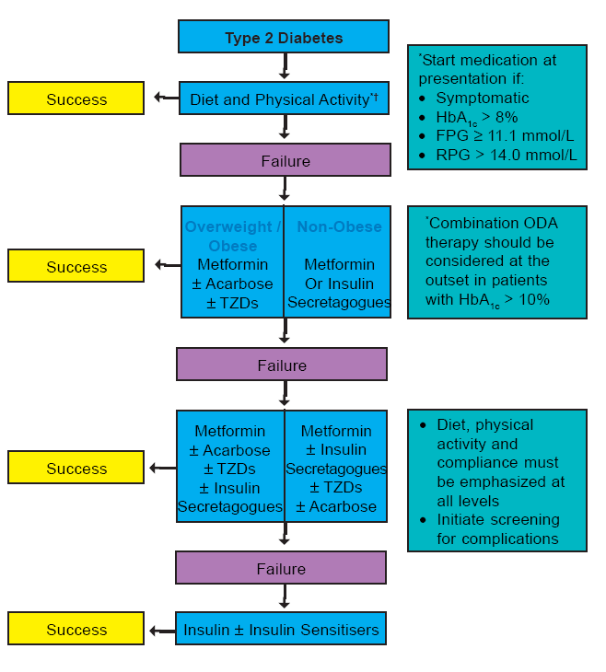
Diabetes Management Algorithm

Slide 47
AGENTS USED FOR TREATMENT OF TYPE 1 OR TYPE2 DIABETES
Mechanism of Action |  | Examples | HbA1c Reduction(%) | Agent-Specific Advantages | Agent-Specific Disadvantages
ORAL
Biguanides | ↓ Hepatic glucose production | Metformin | 1-2 | Weight neutral, do not cause hypoglycemia , inexpensive , extensive experience, ↓ CV events | Diarrhea, nausea, lactic acidosis
ἁ-Glucosidase inhibitors | ↓ Gl glucose absorption | Acarbose, miglitol, voglibose | 0.5-o.8 | Reduce postprandial glycemia | Gl flatulence, liver function tests
Dipeptidyl peptidase IV inhibitors | Prolong endogenous GLP-1 action | Alogliptin, Gemigliptin, linagliptin, saxagliptin, sitagliptin, teneligliptin, vildagliptin | 0.5-0.8 | Well tolerated, do not cause hypoglycemia

Slide 48
Insulin secretagogues: Sulfonylureas | ↑ Insulin Scretion | Glibornuride, gliclazide, Glimepiride, Glipizide, Gliquidone, Glyburide, Glyclopyramide | 1-2 | Short onset of action, lower postprandial glucose, inexpensive | Hypoglycemia, weight gain
Insulin secretagogues: Nonsulfonylureas | ↑ Insulin Scretion | Nateglinide, repaglinide, mitiglinide | 0.5-1.0 | Short onset of action, lower post prandial glucose | Hypoglycemia
Sodium-Glucose cotransporter 2 inhibitors | ↑ Urinary glucose excretion | Canagliflozin, Dapagliflozin, empagliflozin | 0.5-1.0 | Insulin secretion and action independent | Urinary and vaginal infections, dehydration, exacebate tendency to hyperkalemia
Thiazolidinediones | ↓Insulin resistance, ↑Glucose utlization | Rosiglitazone, Pioglitazone | 0.5-1.4 | Lower insulin requirements | Peripheral edema, CHF, weight gain, fractures, macular edema

Slide 49
PARENTERAL
Amylin agonists | Slow gastric emptying ↓ glucagon | pramlintide | 0.25-0.5 | Reduce postprandial glycemia, weight loss | Injection, nausea, ↑ risk of hypoglycemia with insulin
GLP-1 receptor agonists | ↑ insulin, ↓glucagon, slow gastric emptying, satiety | Exenatide, liraglutide, dulaglutide | 0.5-1.0 | Weight loss, do not cause hypoglycemia | Injection, nausea, ↑ risk of hypoglycemia with insulin secretagogues
insulin | ↑ glucose utilization ↓ hepatic glucose production, and other anabolic actions | See text and table 418-4 | Not limited | Known safety profile | Injection, weight gain, hypoglycemia

Slide 50
Medical nutrition therapy and physical activity | ↓ insulin resistance, ↑ insulin secretion | Low-calorie, low-fat diet, exercise | 1-3 | Other health benifits | Compliance difficult, long-term success low

Slide 51
C. Insulin Therapy
Short-term use:
Acute illness, surgery, stress and emergencies
Pregnancy
Breast-feeding
Insulin may be used as initial therapy in type 2 diabetes
in marked hyperglycaemia
Severe metabolic decomposition (diabetic ketoacidosis, hyperosmolar nonketotic coma, lactic acidosis, severe hypertriglyceridaemia)
Long-term use:
If targets have not been reached after optimal dose of combination therapy or BIDS, consider change to multi-dose insulin therapy. When initiating this, insulin secretagogues should be stopped and insulin sensitisers e.g. Metformin or TZDs, can be continued.

Slide 52
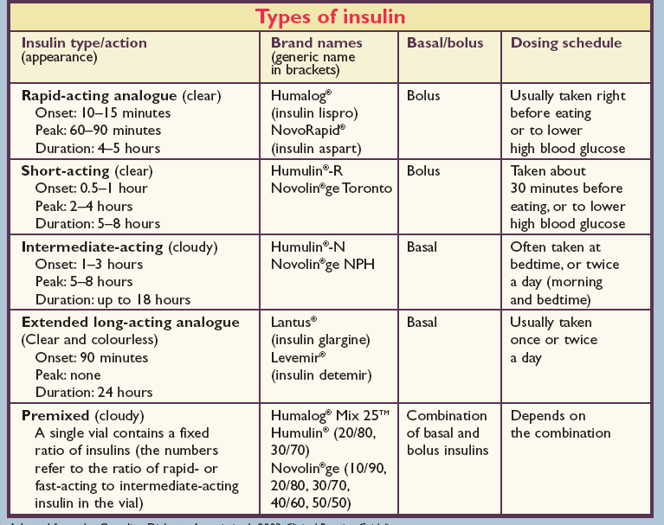

Slide 53
VARIOUS METABOLIC EFFECTS OF INSULIN
Stimulation of the activity of glycol tic enzymes.
Reduce the activity of the enzymes of gluconeogenesis.
Increased synthesis of glycogen.
Increased uptake of glucose by resting skeletal muscles.
Reduction of blood glucose level.
Reduction of lipolysis and stimulation of lipid synthesis.
Prevention of ketogenesis.
Increased transmembrane transport of K+ ions into the cell.
Acceleration of protein synthesis and enhancement of tissue uptake of amino acids

Slide 54
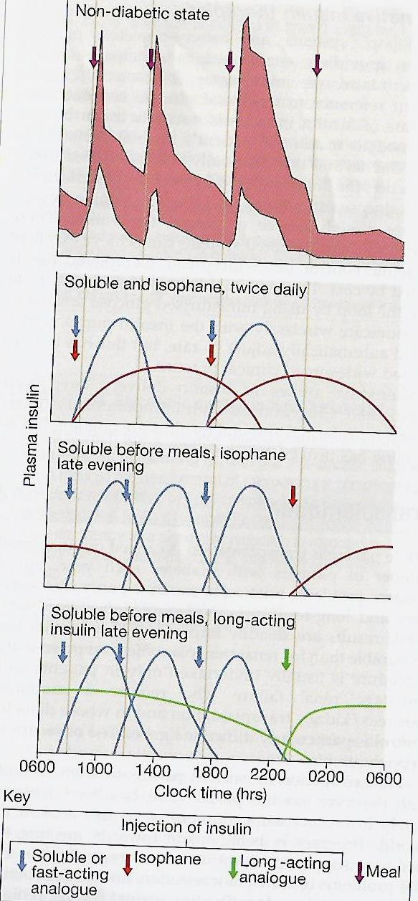
DIFFERENT INSULIN REGIMENS

Slide 55
Insulin regimens
The majority of patients will require more than one daily injection if good glycaemic control is to be achieved. However, a once-daily injection of an intermediate acting preparation may be effectively used in some patients.
Twice-daily mixtures of short- and intermediate-acting insulin is a commonly used regimen.
In some cases, a mixture of short- and intermediate-acting insulin may be given in the morning. Further doses of short-acting insulin are given before lunch and the evening meal and an evening dose of intermediate-acting insulin is given at bedtime.
Other regimens based on the same principles may be used.
A regimen of multiple injections of short-acting insulin before the main meals, with an appropriate dose of an intermediate-acting insulin given at bedtime, may be used, particularly when strict glycaemic control is mandatory.

Slide 56
SIDE-EFFECTS OF INSULIN THERAPY
Hypoglycemia
Weight gain
Peripheral oedema (insulin treatment causes salt and water retention in the short term)
Insulin antibodies (with animal insulins)
Local allergy (rare)
Lipohypertrophy or lipoatrophy at injection sites.

Slide 57
COMPLICATIONS OF DIABETES MELLITUS
ACUTE COMPLICATIONS:
Diabetic ketoacidosis (DKA)
Hyperosmolar nonketotic diabetic coma (HONC)
Hypoglycemic coma (usually due to therapy)
Lactic acidosis.
Infections (Boils)

Slide 58
HYPOGLYCAEMIA
Hypoglycemia (blood glucose < 3.5 mmol/L (63 mg/dL)) in diabetes results in most circumstances from insulin therapy, less frequently from use of oral insulin secretagogues such as sulphonylurea drugs, and rarely with other anti-diabetic drugs. When hypoglycemia develops in non-diabetic People, it is called ‘spontaneous’ hypoglycemia.

Slide 59
HYPOGLYCAEMIA IN DIABETES: COMMON CAUSE AND RISK FACTORS
CAUSE OF HYPOGLYCAEMIA:
Missed, delayed or inadequate meal.
Unexpected or unusual exercise.
Alcohol.
Errors in oral anti-diabetic agents(s) or insulin dose/schedule/administration.
Poorly designed insulin regimen, particularly if predisposing to nocturnal hyperinsulinaemia.
Lipohypertrophy at injection sites causing variable insulin absorption.
Gastroparesis due to autonomic neuropathy causing variable carbohydrate absorption.
Malabsorption, e.g. coeliac disease.
Unrecognised other endocrine disorder, e.g. Addison’s disease.
Factitious (deliberately induced).
Breastfeeding.

Slide 60
ADRENERGIC AND NEUROGLUCOPENIC SYMPTOMS OF HYPOGLYCEMIA
ADRENERGIC SYMPTOMS | NEUROGLUCOPENIC SYMPTOMS
Shakiness | Abnormal mentation, confusion, difficulty in thinking
Trembling | Double vision, tube vision
Anxiety | Irritability
Nervousness | Difficulty in speaking, slurred speech
Palpitations | Ataxia
Clamminess | Paresthesia

Slide 61
ADRENERGIC SYMPTOMS | NEUROGLUCOPENIC SYMPTOMS
Sweating | Headaches
Dry mouth | Stupor
Hunger | Seizures
Pallor | Coma
Pupil dilation | Death (if untreated)

Slide 62
RISK FACTORS FOR SEVERE HYPOGLYCAEMIA
Strict glycaemic control
Impaired awareness of hypoglycemia.
Age (very young and elderly)
Long duration of diabetes
Sleep
C-Peptide negativity (indicating complete insulin deficiency)
History of previous severe hypoglycemia
Renal impairment
genetic, e.g. angiotensin-converting enzyme (ACE) genotype.

Slide 63
TREATMENT OF HYPLOGLYCEMA
To conscious patient – oral glucose 20 gms state.
Unconscious patient- parental glucose 25 gms.
Glucagon -1 mg s/c in adults.

Slide 64
DIABETIC KETOACIDOSIS (DKA)
DKA is characteristic of Type-1 diabetes
DKA result from relation on absolute insulin deficiency.
Counter regulation hormones excess.
Glucogon, catecholomine, contisal & growth hormone.
THE CARDIVAL BIOCHEMICAL FEATURES ARE:
Hyperketonaemia (≥ 3 mmol/L) and ketonuria
Hyperglycemia (250-600 mg%)
Metabolic acidosis (PH-6.8-7.3)

Slide 65
SIGNS AND SYMPTOMS OF DIABETIC KETOACIDOSIS
Vomiting
Increased urination
Abdominal pain
Fruity odor to breath
Dry mouth and tongue
Drowsiness
Deep breathing
Coma
Decreased skin Turgor
Prolonged capillary refill time

Slide 66
PRECIPITATING FACTORS FOR DIABETIC KETOACIDOSIS
MOST COMMON
Infections (urinary tract infection, pneumonia)
Medication noncompliance
Inadequate insulin dosing
New onset diabetes mellitus
LESS COMMON
Acute pancreatitis
Trauma
Pregnancy
Surgery
Medications (thiazides, steroids, phenytoin, dopamine)

Slide 67
TREATMENT:
Insulin
Fluid & Electrolyte replacement

Slide 68
HYPERGLYCAEMIC HYPEROSMOLAR STATE
Hyperglycemic Hyperosmolar State (HSS) is character by:
Severe hyperglycemia > 600 mg/ dl.
Hyperosmolylity > 320 mOsm/kg.
Dehydration due to osmotic fluid loss.
Absence of significant hyperketonaemia (<3 mmol/L)
TREATMENT:
Fluid and electrolyte replacement.
Insulin parental .

Slide 69
INFECTION:
Infection in diabetes in common because abnormality in cell mediate immunity and phagocyte function associated with hyperglycemia
Common infections are:
Fungal infection
Pulmonary tuberculosis
UTI by- e-coli.
Furuenculosis
pneumonia
Skin and soft tissue infections
Valvovaginitis.

Slide 70
The Long Term Effects Of Diabetes
The long term effects of diabetes can be divided into
  Macrovascular complications.
  Microvascular complications.
Macrovascular complications affect the larger blood vessels, such as those supplying blood to the heart, brain and legs. The most common macrovascular fatal complication is coronary artery disease. Strokes are also a common cause of disability and death in people with diabetes.
Microvascular complications affect the small blood vessels, such as those supplying blood to the eyes and kidneys. The microvascular complications of diabetes are retinopathy, nephropathy and neuropathy.
Notes:
Modified from the IDF publication: ‘Cost Effective Approaches to Diabetes Care and Prevention’, p. 7

Slide 71
COMPLICATIONS OF DIABETES
Despite all the treatments now available, the outcome for patients with diabetes remains disappointing. Long-term complications of diabetes still cause significant morbidity and mortality.

Slide 72
PATHOGENESIS
Numerous clinical studies have implicated endothelial dysfunction as the principal course of macrovascular and microvascular complications seen in both type 1 and type 2 diabetes. Endothelial cells regulate vascular tone by releasing endothelium-derived relaxing factors (EDRF), which include nitric oxide, prostacyclin and endothelium derived hyperpolarizing factor.

Slide 73
COMPLICATIONS OF DIABETES
MICROVASCULAR/NEUROPATHIC:
Retinopathy, cataract
Impaired vision
Nephropathy
Renal failure
Peripheral neuropathy
Sensory loss
Pain
Motor weakness
Automatic neuropathy
Gastrointestinal problems (gastro paresis; altered bowel habit)
Postural hypertension

Slide 74
Foot disease
Ulceration
Arthropathy
MACROVASCULAR:
Coronary circulation
Myocardial ischaemia/infarction
Cerebral circulation
Transient ischaemic attack
Stroke
Peripheral circulation
Claudication
Ischaemia

Slide 75
RISK FACTORS FOR INCREASED MORBIDITY AND MORTALITY IN DIABETES
Duration of diabetes
Early age at onset of disease
High glycated haemoglobin (Hba1c)
Raised blood pressure
Proteinuria; microalbuminuria
Dyslipidaemia
Obesity

Slide 76
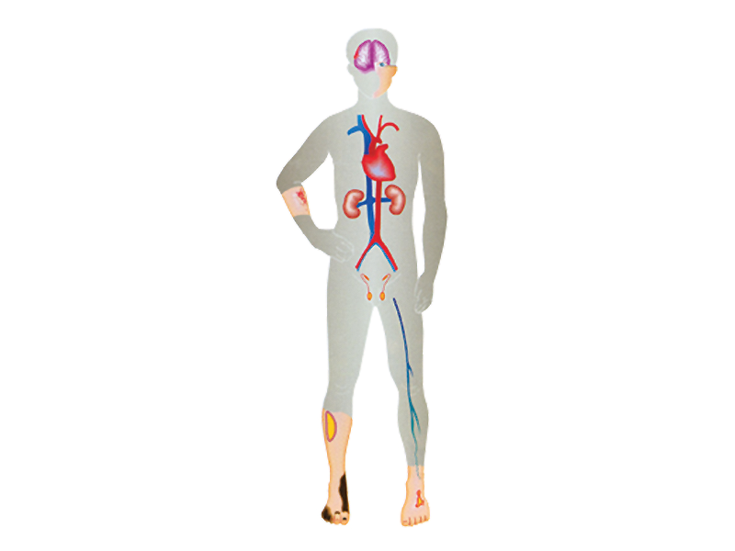
THE MAJOR DIABETIC COMPLICATIONS
Stroke
(cerebrovascular disease)
Visual impairment:
diabetic retinopathy,
cataract and glaucoma
Heart disease
(cardiovascular disease)
Bacterial and fungal
infections of the skin
Kidney disease
(diabetic nephropathy)
Severe hardening of
the arteries (atherosclerosis)
Autonomic neuropathy
(including slow emptying
of the stomach and diarrhea)
Sexual dysfunction
Poor blood supply to lower limbs
(peripheral vascular disease)
Necrobiosis lipidoica
Sensory impairment
(peripheral neuropathy)
Gangrene
Ulceration
Notes:
From the IDF publication: ‘Cost Effective Approaches to Diabetes Care and Prevention’, p.10

Slide 77
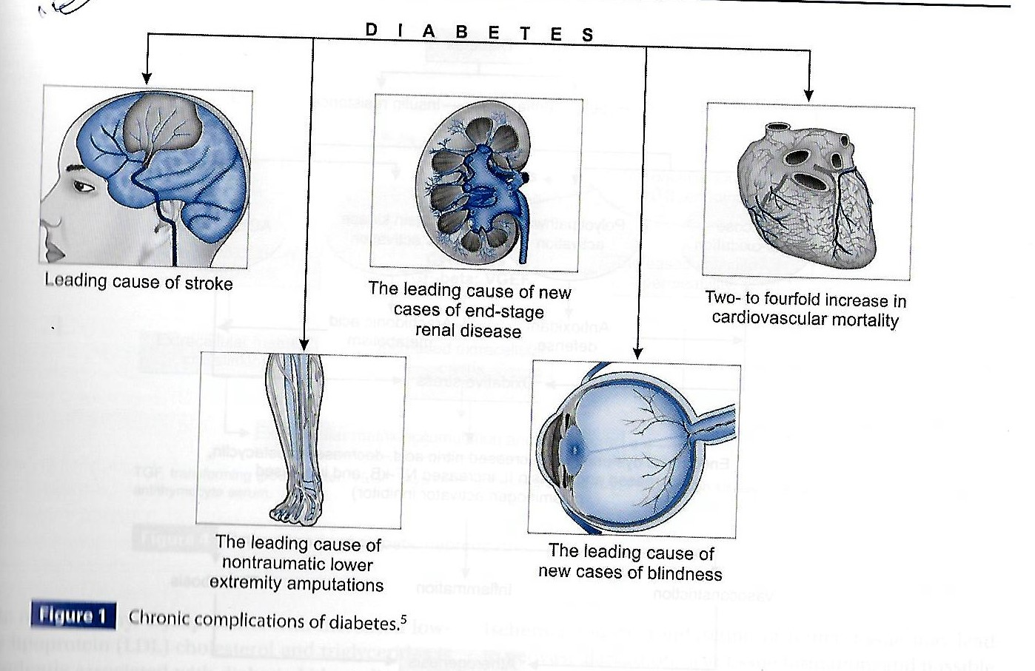

Slide 78
PREVENTING DIABETES COMPLICATIONS
Glycaemic control:
The evidence that improved glycaemic control decreases the risk of developing microvascular complications of diabetes was established by the Diabetes control and Complications Trial (DCCT) in type 1 diabetes, and the UK prospective Diabetes Study (UKPDS) in type 2 diabetes. The DCCT was a large study that lasted 9 years.

Slide 79
CONTROL OF OTHER RISK FACTORS
Randomized controlled trials have shown that aggressive management of blood pressure minimizes the microvascular and macrovascular complications of diabetes. Angiotension-converting enzyme (ACE) inhibitors are valueable in improving outcome in heart disease and in treating diabetic nephropathy. The management of dyslipidaemia with a stain limits macrovascular disease in people with diabetes. This often results in the necessary use of multiple medications, which exacerbates the problem of adherence to therapy by patients; it is not unusual for a patient to be taking two or more diabetes therapies, two or more blood pressure drugs and a stain.

Slide 80
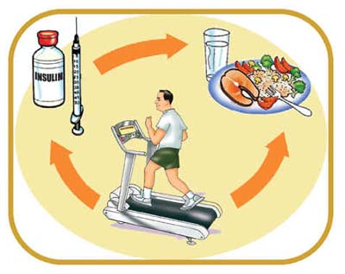
SELF-CARE
Patients should be educated to practice self-care. This allows the patient to assume responsibility and control of his / her own diabetes management. Self-care should include:
  Blood glucose monitoring
  Body weight monitoring
  Foot-care
  Personal hygiene
  Healthy lifestyle/diet or physical activity
  Identify targets for control
  Stopping smoking

Slide 81
Prevention or delay of diabetes:
Life style modification
Research studies have found that lifestyle changes can prevent or delay the onset of type 2 diabetes among high-risk adults.
These studies included people with IGT and other high-risk characteristics for developing diabetes.
Lifestyle interventions included diet and moderate-intensity physical activity (such as walking for 2 1/2 hours each week).
In the Diabetes Prevention Program, a large prevention study of people at high risk for diabetes, the development of diabetes was reduced 58% over 3 years.

Slide 82
Prevention or delay of diabetes: Medications
Studies have shown that medications have been successful in preventing diabetes in some population groups.
In the Diabetes Prevention Program, people treated with the drug metformin reduced their risk of developing diabetes by 31% over 3 years.
Treatment with metformin was most effective among younger, heavier people (those 25-40 years of age who were 50 to 80 pounds overweight) and less effective among older people and people who were not as overweight.
Similarly, in the STOP-NIDDM Trial, treatment of people with IGT with the drug acarbose reduced the risk of developing diabetes by 25% over 3 years.
Other medication studies are ongoing. In addition to preventing progression from IGT to diabetes, both lifestyle changes and medication have also been shown to increase the probability of reverting from IGT to normal glucose tolerance.

Slide 83
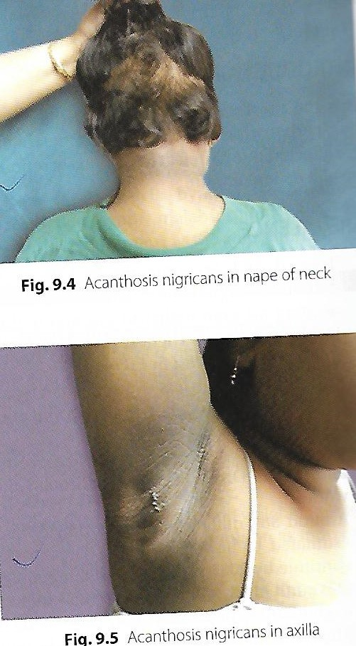

Slide 84
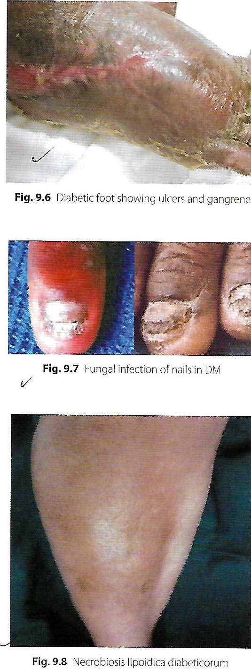

Slide 85
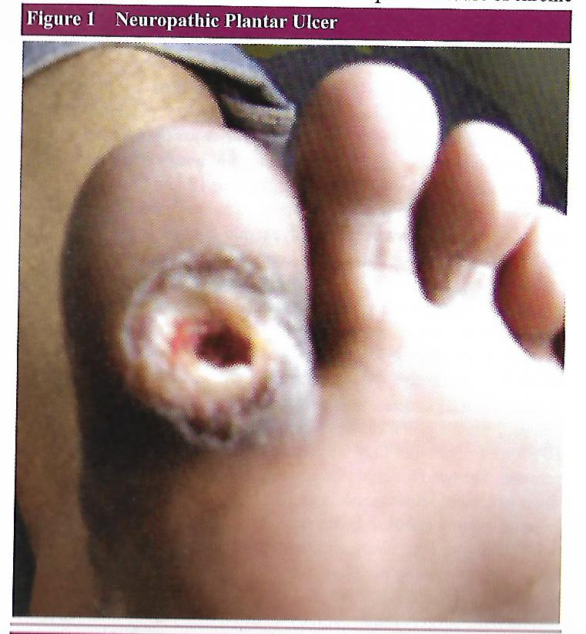

Slide 86
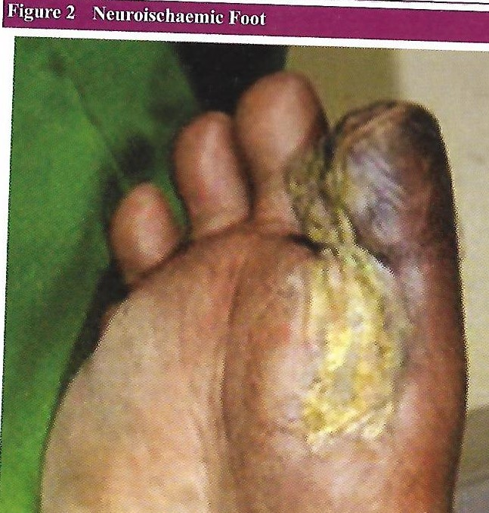

Slide 87
HOW TO REVIEW A PATIENT IN THE DIABETES CLINIC
LIFESTYLE ISSUES:
GENERAL HEALTH
WORK OR SCHOOL
SMOCKING
ALCOHOL INTAKE
STRESS OR DEPRESSION
SEXUAL HEALTH
EXERCISE

Slide 88
BODY WEIGHT AND BMI-SHOULD BE MAINTAIN
BLOOD PRESSURE:
Individualized target of 130-140/70-80 mmHg, depending on risk factors and presence of nephropathy.
URINALYSIS:
Analyse fasting specimen for glucose, ketones, albumin (both macro- and micro-albuminuria)
BIOCHEMISTRY:
Renal, liver and thyroid function
Lipid profile and estimated 10-yr cardiovascular risk to guide need for lipid-lowering therapy.

Slide 89
GLYCAEMIC CONTROL:
Glycated haemoglobin (HBA); individualized target between 48 and 58 mmol/mol (6.5 and 7.5%)
Inspection of home blood glucose monitoring record (if carried out by patient)
HYPOGLYCAEMIC EPISODES:
Number and cause of severe (requiring assistance for treatment) events and frequency of mild (self-treated) episodes and biochemical hypoglycemia.
Awareness of hypoglycemia.
Driving advice

Slide 90
TAKE HOME MESSAGE
PREVENTION IS BETTER THAN CURE SO -MAINTAIN BODY WEIGHT AND DO REGULAR PHYSICAL EXERCISE.
BE ADHRENT TO DIABETIC TREATMENT AND FOLLOW UP THOSE WHO ARE DIABETIC TO PREVENT DIABETIC COMPLICATION.

Slide 91
THANKS

